Slide 1


Actions & Basic Transformations

Slide 2
Content
Introduction & Presentation ETL Process
Actions & Basic Transformations
Advanced Transformations
Databricks

Slide 3

Goal of the learning sections
Perform Basic Transformation
Perform Conditional Selection of Rows
Carry out basic Data Cleaning

Slide 4

Importing Data
Importing Data with .spark.read.options()

Slide 5
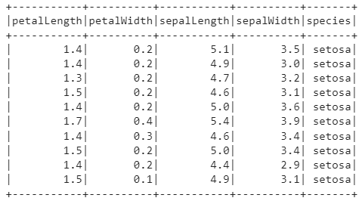
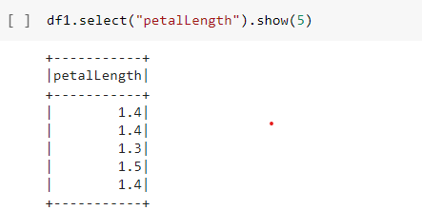
Accessing Columns
Accessing columns with .select()

Slide 6
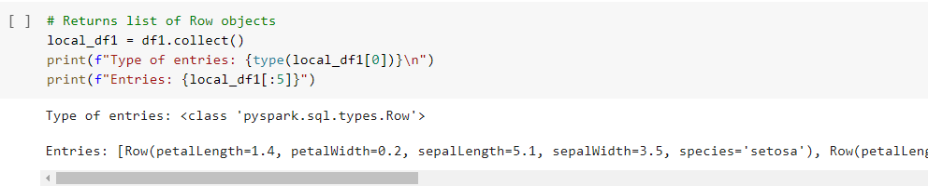
Accessing Rows
Accessing columns with workaround .collect() then access with print()
(and square brackets-operator for row)

Slide 7
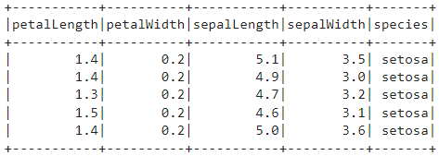
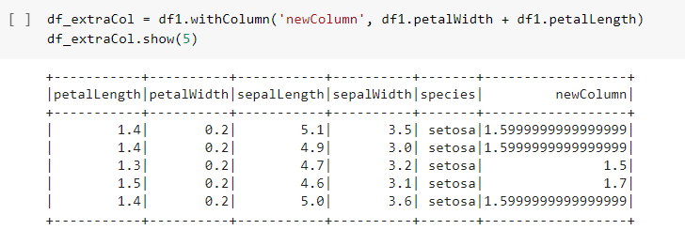
Adding Columns
Adding columns with .withColumn()

Slide 8
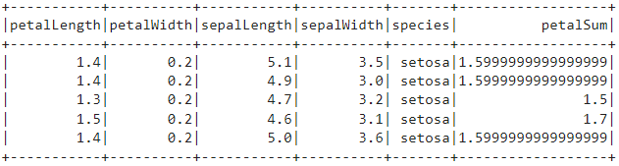
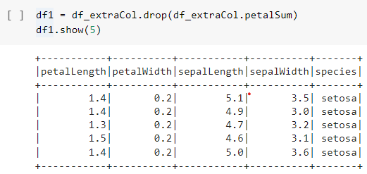
Removing Columns
Removing columns with .drop()

Slide 9
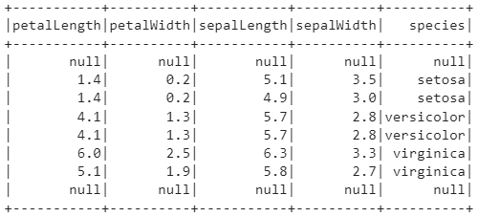

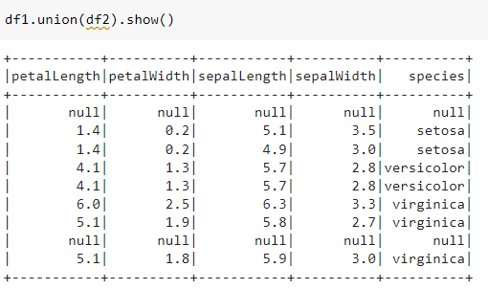
Concatenating DataFrames
Concatenating dataframes with .union()

Slide 10

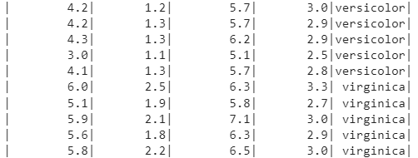
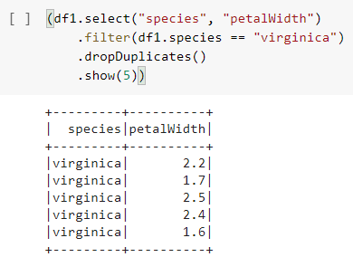
Perform Conditional Selection of Rows
Combining aggregate functions, to achieve exact selection: .filter()
.where()
.withColumn()
…

Slide 11
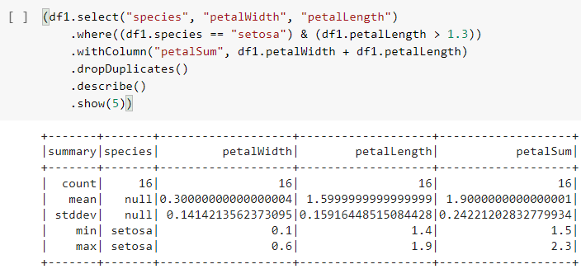
Perform Conditional Selection of Rows

Slide 12
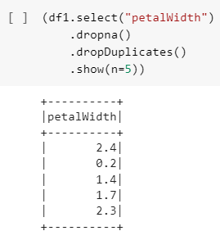
basic Data Cleaning
Removing NAs with .dropna()
Removing duplicates with .dropDuplicates()

